Slide 1
Machine Learning
Raghu Prasad K S

Slide 2
Introduction
Raghu Prasad – BE, MS
Total of 24 years of experience
7 years as a lecturer in Engineering College
17 Years into IT
Worked with companies like CISCO,CSC,ICICI,First Apex – NTT Data
Currently into Corporate training and consultancy
Worked with corporates and public sector
Technologies – Java,Python,Data Sciences,Web technologies,Java Script technologies (MEAN stack),IOT,Test Automation – Selenium,JMeter

Slide 3
Course Outline
Types of Machine Learning
Machine Learning Algorithms
Machine learning examples

Slide 4
Types of Machine Learning Algorithms
Broadly, there are 3 types of Machine Learning Algorithms
1. Supervised Learning
How it works: This algorithm consist of a target / outcome variable (or dependent variable) which is to be predicted from a given set of predictors (independent variables). Using these set of variables, we generate a function that map inputs to desired outputs. The training process continues until the model achieves a desired level of accuracy on the training data.
Examples of Supervised Learning: Regression, Decision Tree, Random Forest, KNN, Logistic Regression etc.

Slide 5
Types of Machine Learning Algorithms
2. Unsupervised Learning
How it works: In this algorithm, we do not have any target or outcome variable to predict / estimate. It is used for clustering population in different groups, which is widely used for segmenting customers in different groups for specific intervention.
Examples of Unsupervised Learning: Apriori algorithm, K-means.

Slide 6
Types of Machine Learning Algorithms
3. Reinforcement Learning:
How it works: Using this algorithm, the machine is trained to make specific decisions. It works this way: the machine is exposed to an environment where it trains itself continually using trial and error. This machine learns from past experience and tries to capture the best possible knowledge to make accurate business decisions. Example of Reinforcement Learning: Markov Decision Process

Slide 7
Common ML Algorithms
Linear Regression
Logistic Regression
Decision Tree
SVM
Naive Bayes
kNN
K-Means
Random Forest
Dimensionality Reduction Algorithms
Gradient Boosting algorithms
GBM ,XGBoost,LightGBM,CatBoost
REFERENCE - https://www.analyticsvidhya.com/blog/2017/09/common-machine-learning-algorithms/

Slide 8
Linear Regression – Supervised ML
Use case
Year of Experience vs Salary
Find out the correlation between Salary and experience

Slide 9
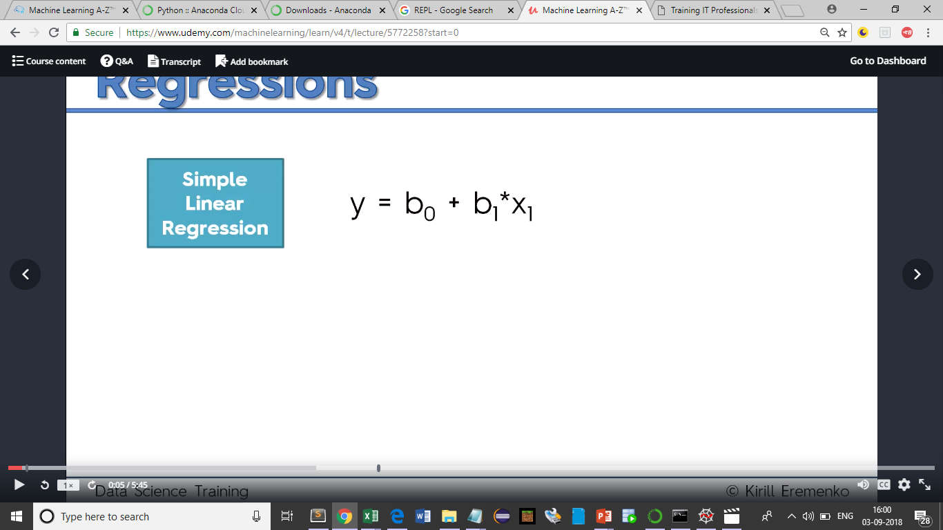
Linear Regression

Slide 10

Linear Regression

Slide 11
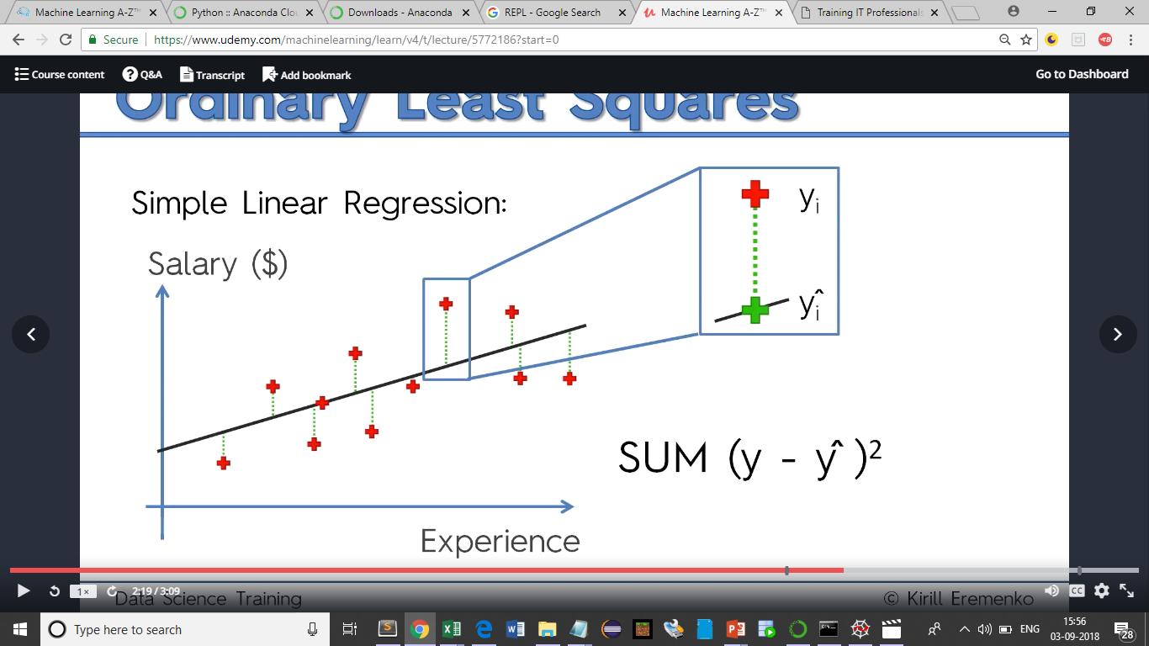
Linear Regression

Slide 12
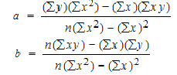
Linear Regression
y = ax + b
Linear regression is a way to model the relationship between two variables. You might also recognize the equation as the slope formula. The equation has the form Y=a+bX, where Y is the dependent variable (that’s the variable that goes on the Y axis), X is the independent variable (i.e. it is plotted on the X axis), b is the slope of the line and a is the y-intercept.

Slide 13
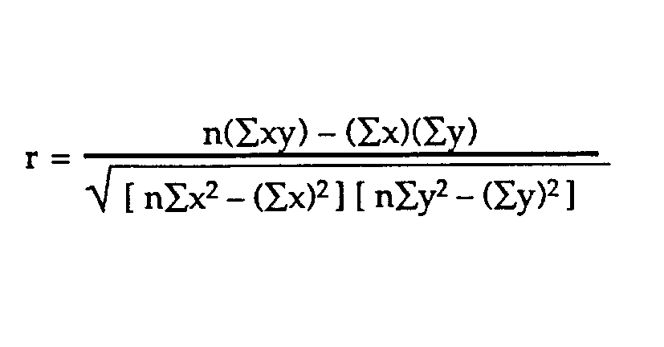
Linear Regression - Correlation coefficients
Correlation coefficients are used in statistics to measure how strong a relationship is between two variables. There are several types of correlation coefficient: Pearson’s correlation (also called Pearson’s R) is a correlation coefficient commonly used in linear regression. If you’re starting out in statistics, you’ll probably learn about Pearson’s R first. In fact, when anyone refers to the correlation coefficient, they are usually talking about Pearson’s.
http://www.statisticshowto.com/probability-and-statistics/correlation-coefficient-formula/

Slide 14
Degree of polynomial - Linear
Degree 1 - Linear Polynomials - After combining the degrees of terms if the highest degree is 1 it is called Linear Polynomials
Examples of Linear Polynomials are
2x : This can also be written as 2x1, as the highest degree of this term is 1 it is called Linear Polynomial
2x + 2 :
This can also be written as 2x1 + 2
Term 2x has the degree 1 .
Term 2 has the degree 0.
As the highest degree we can get is 1 it is called Linear Polynomial
2x + 2y + 2 :
This can also be written as 2x1 + 2y1 + 2
Term 2x has the degree 1
Term 2y also has the degree 1
Term 2 has the degree 0
As the highest degree we can get is 1 it is called Linear Polynomial

Slide 15
Degree of polynomial - Quadratic
Degree 2 - Quadratic Polynomials - After combining the degrees of terms if the highest degree of any term is 2 it is called Quadratic Polynomials
Examples of Quadratic Polynomials are `
After combining the degrees of term 2xy the sum total of degree is 2.
Term 2y has the degree 1
As the highest degree we can get is 2 it is called Quadratic Polynomial
2xy + 2y - 1 -
This can also be written as 2x1y1 + 2y1 - 1
After combining the degrees of term 2xy, the sum total of degree is 2.
Term 2y has the degree 1
Term 1 has the degree 0.
As the highest degree we can get is 2 it is called Quadratic Polynomial

Slide 16
Degree of polynomial - Cubic
Degree 3 - Cubic Polynomials - After combining the degrees of terms if the highest degree of any term is 3 it is called Cubic Polynomials Examples of Cubic Polynomials are 2x3 : This is a single term having highest degree of 3 and is therefore called Cubic Polynomial.
2x3 + 2y2 :
Term 2x3 has the degree 3
Term 2y2 has the degree 2
As the highest degree we can get is 3 it is called Cubic Polynomial
2x3 + 2y2 + 2 :
Term 2x3 has the degree 3
Term 2y2 has the degree 2.
Term 2 has the degree 0
As the highest degree we can get is 3 it is called Cubic Polynomial
2xyz + 2y + 2 : After combining the degrees of term 2xyz, the sum total of degree is 3, as highest degree of term is 3 it is called Cubic Polynomial

Slide 17
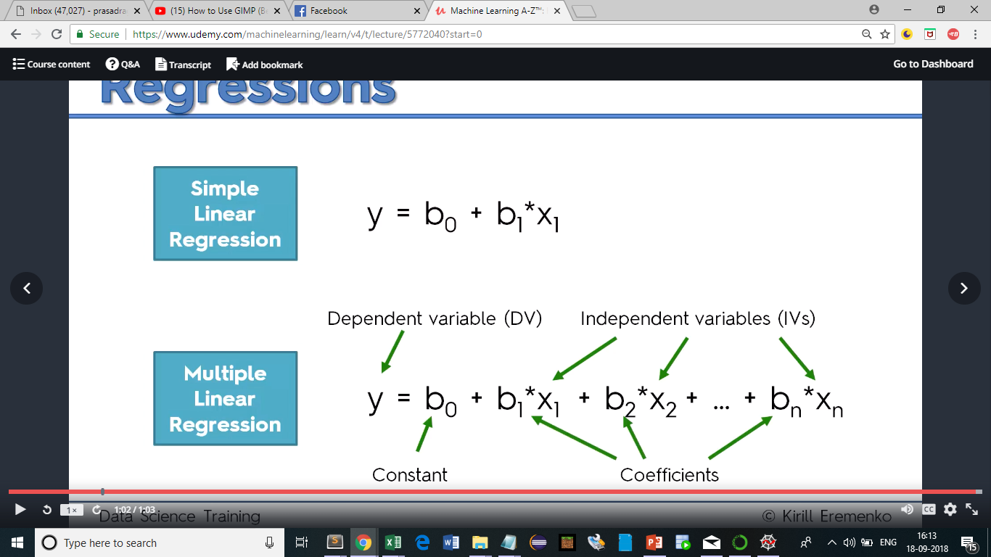
Supervised learning algorithms
Multiple Linear Regression

Slide 18
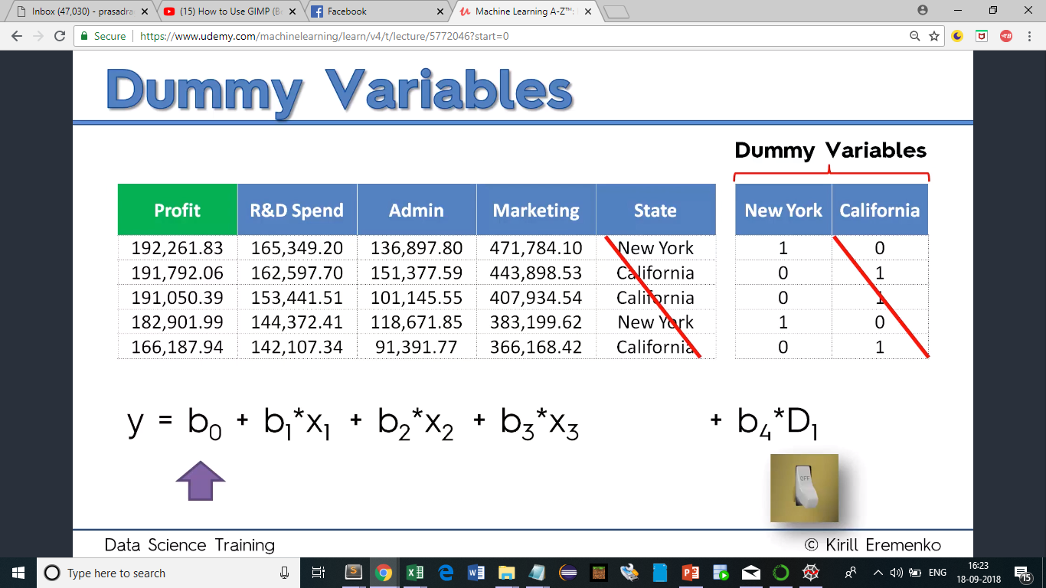
Supervised learning algorithms – Multiple Linear

Slide 19
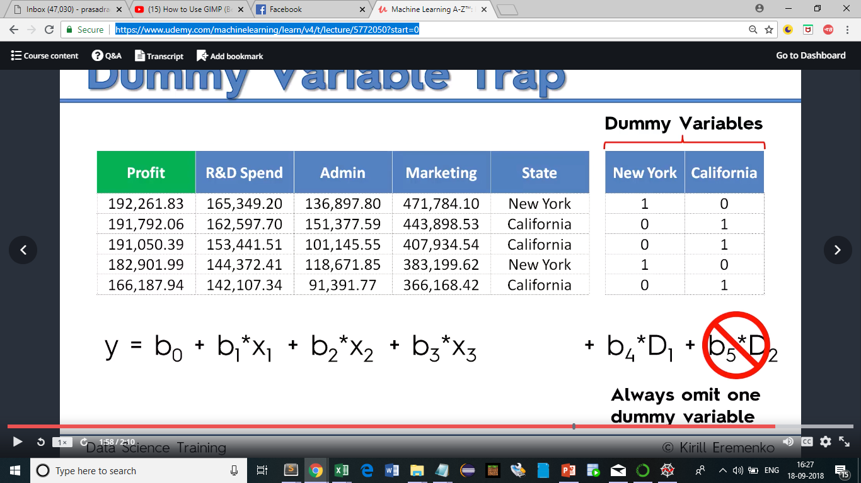
Supervised learning algorithms – Multiple Linear

Slide 20
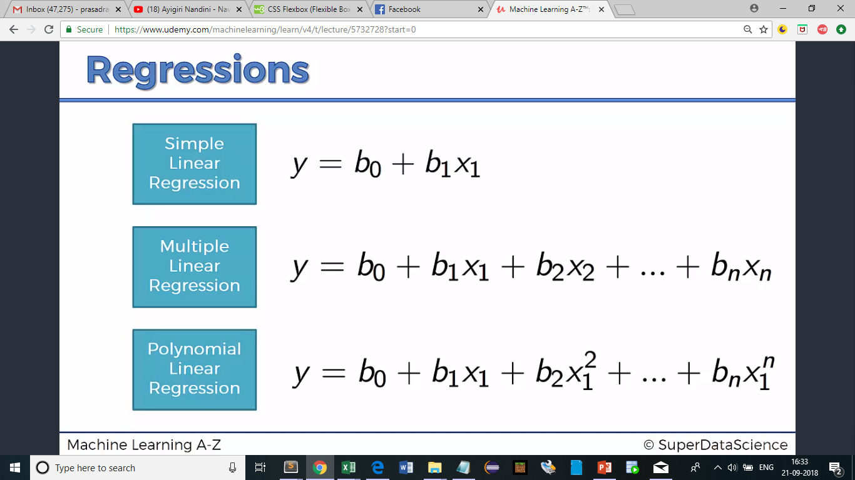
Supervised learning algorithms – Polynomial Linear Regression

Slide 21
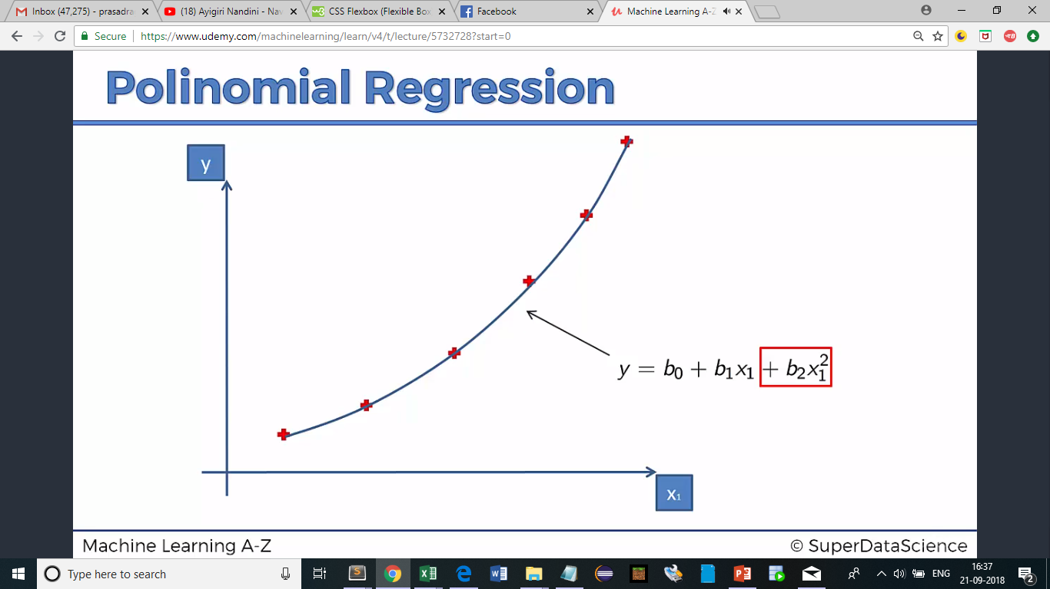
Supervised learning algorithms – Polynomial Linear Regression

Slide 22
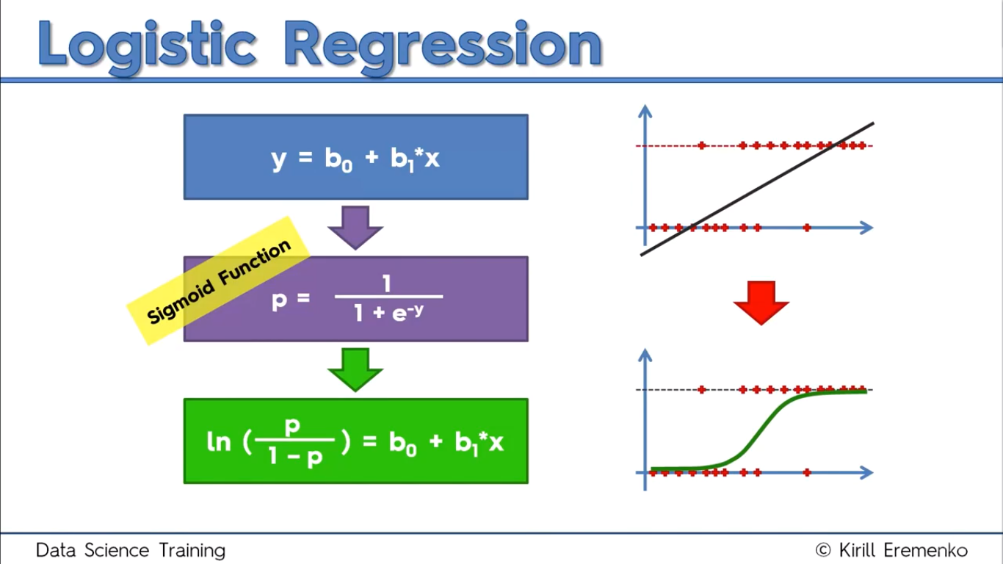
Supervised learning algorithms – Logistic Regression

Slide 23
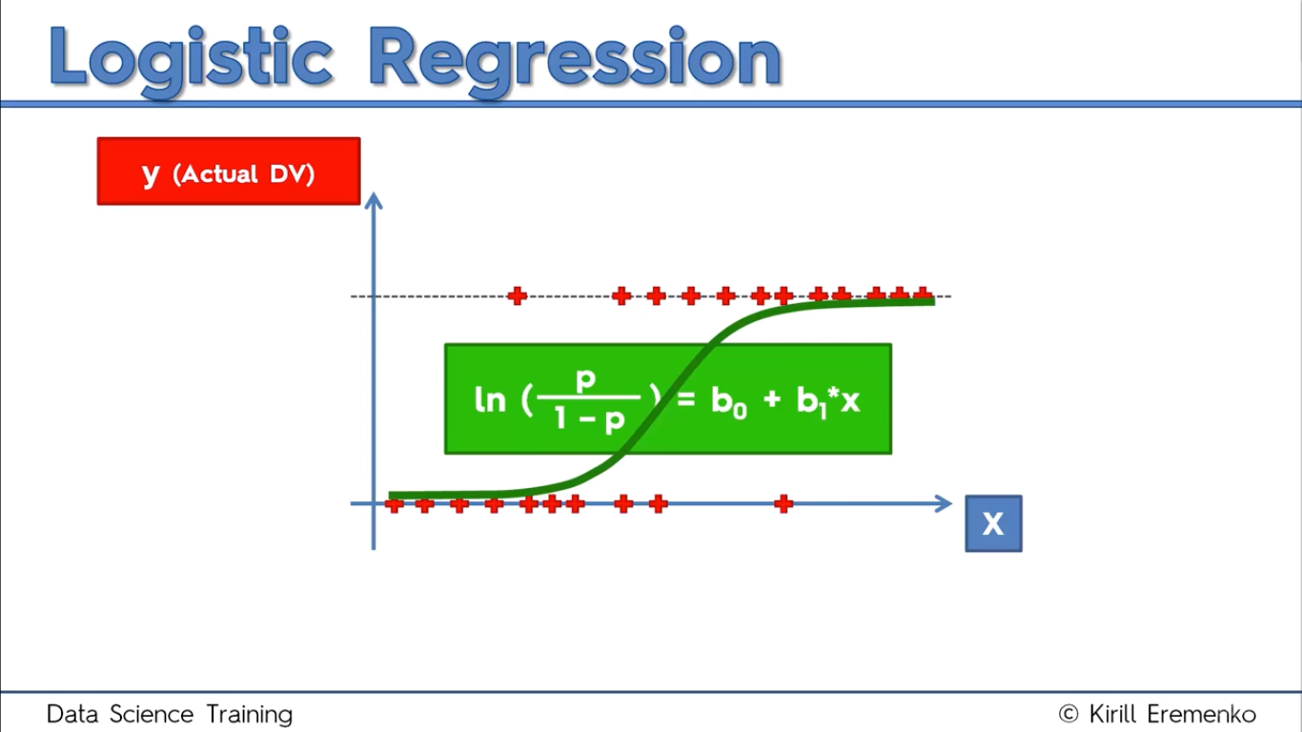
Supervised learning algorithms – Logistic Regression

Slide 24
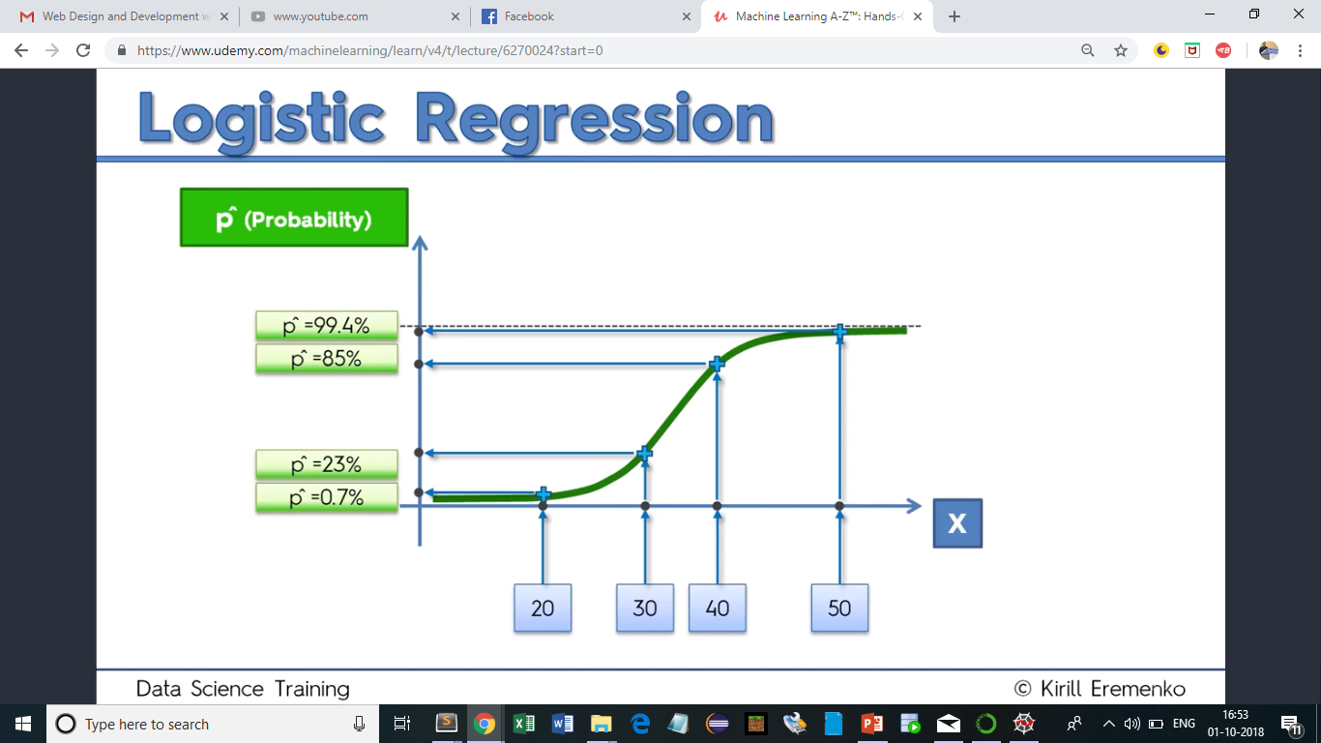
Supervised learning algorithms – Logistic Regression

Slide 25
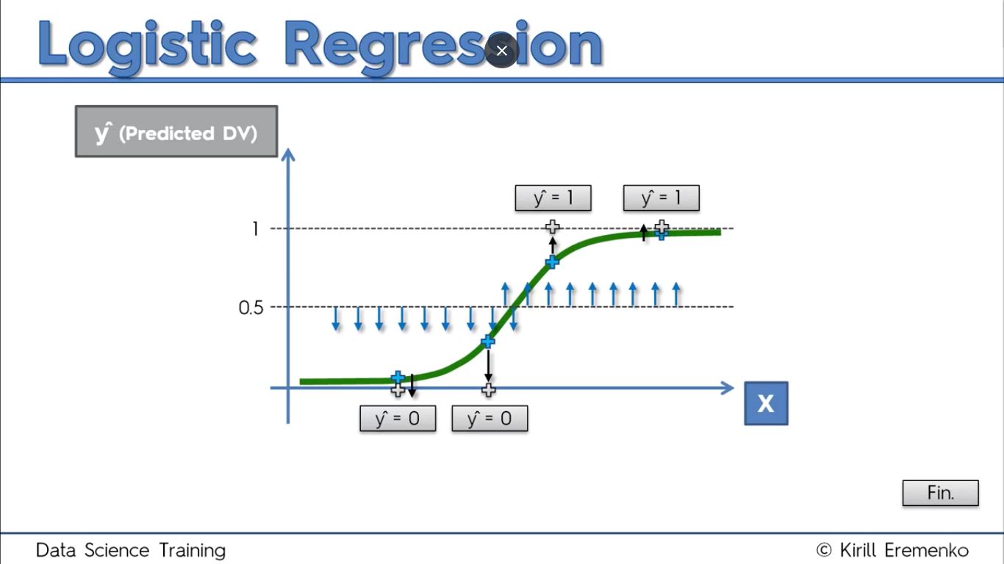
Supervised learning algorithms – Logistic Regression

Slide 26
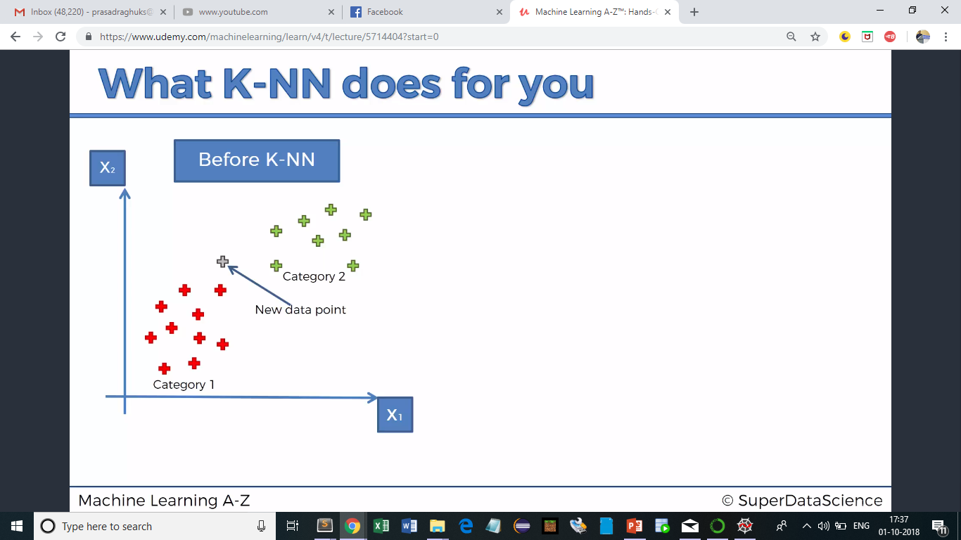
Supervised learning algorithms – K Nearest Neighbour Algorithm

Slide 27
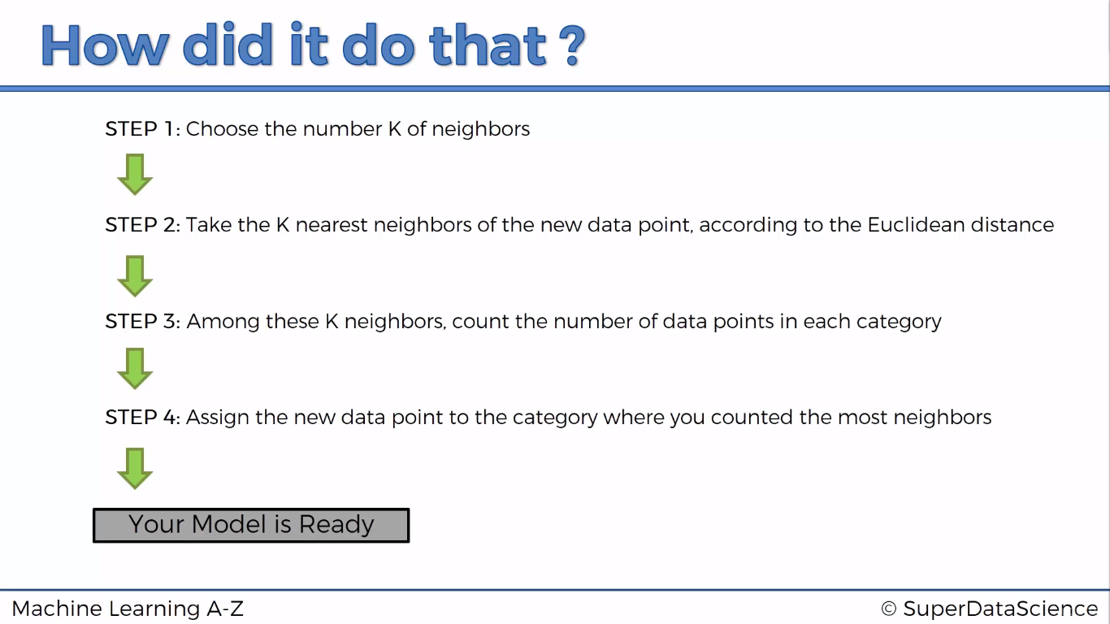
Supervised learning algorithms – K Nearest Neighbour Algorithm

Slide 28
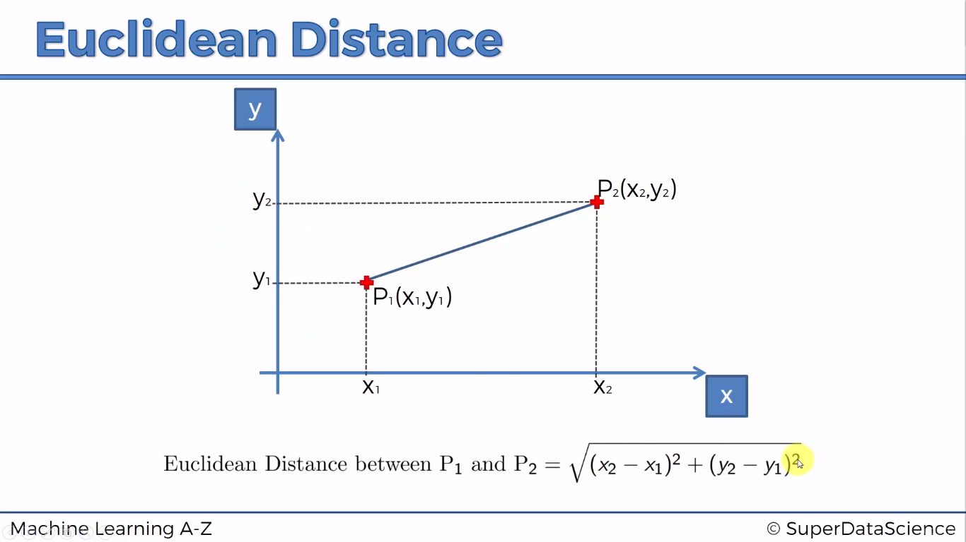
Supervised learning algorithms – K Nearest Neighbour Algorithm

Slide 29
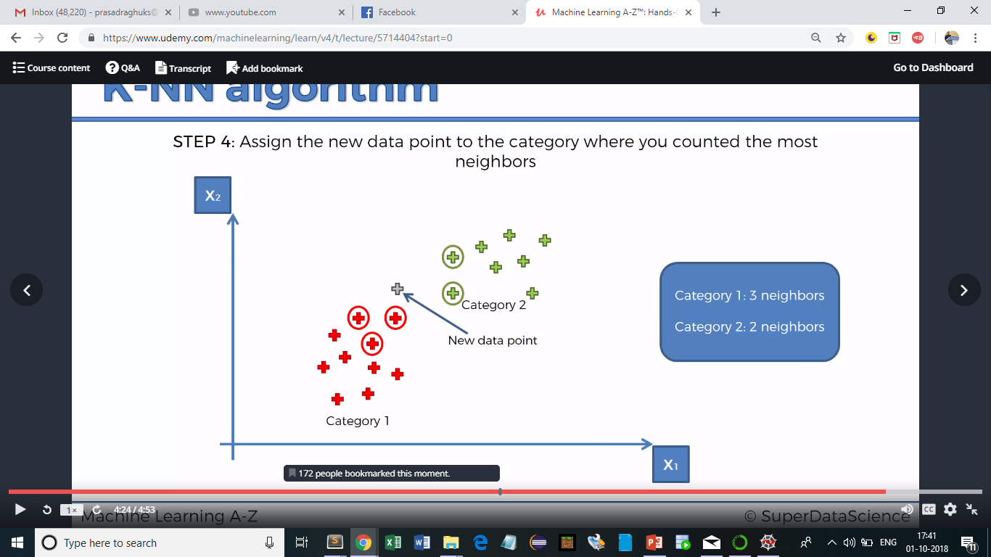
K Nearest Neighbour Algorithm

Slide 30
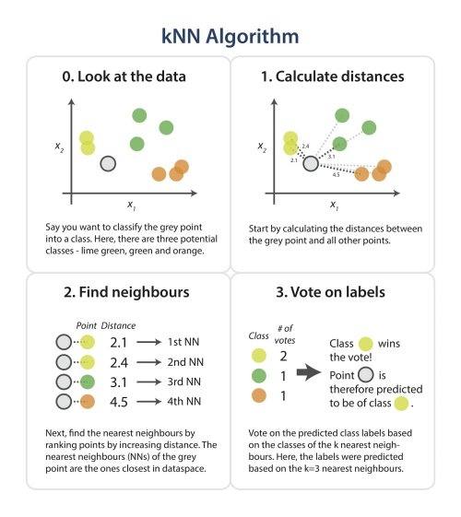
KNN

Slide 31
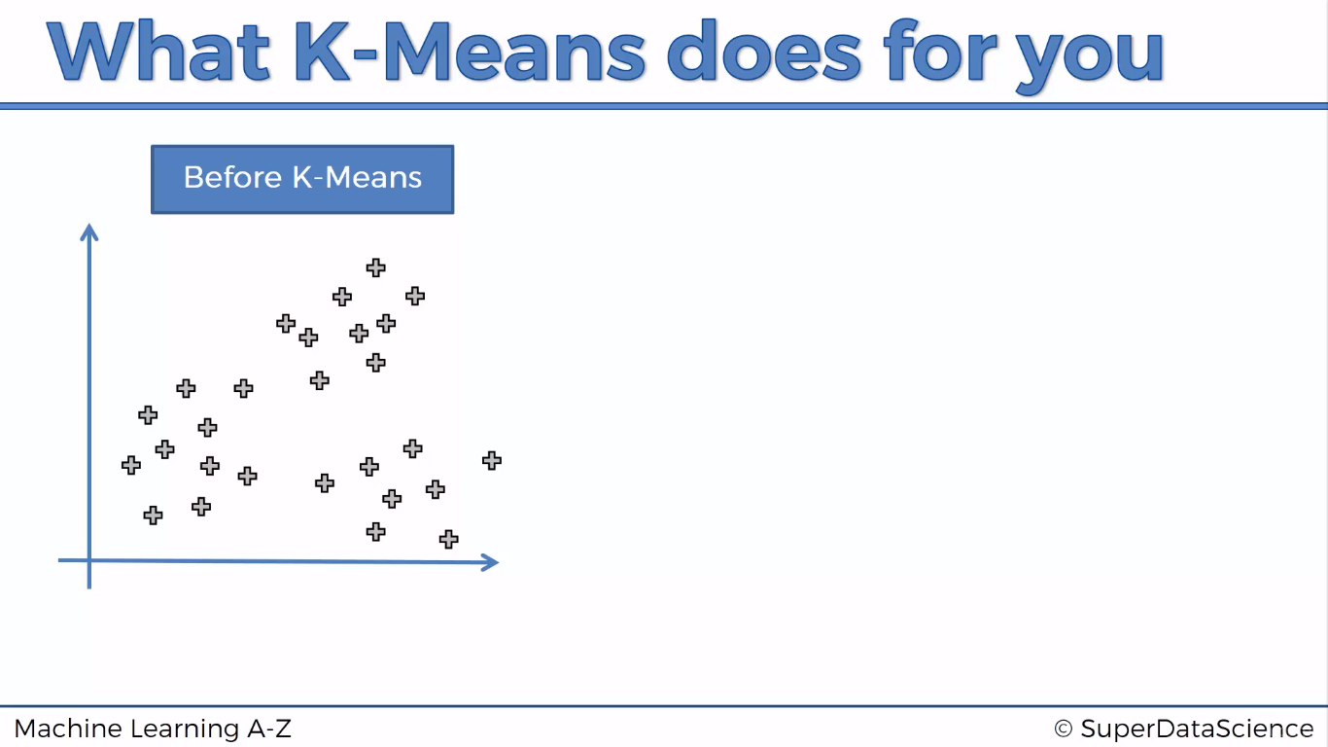
K-Means Clustering – Supervised ML

Slide 32
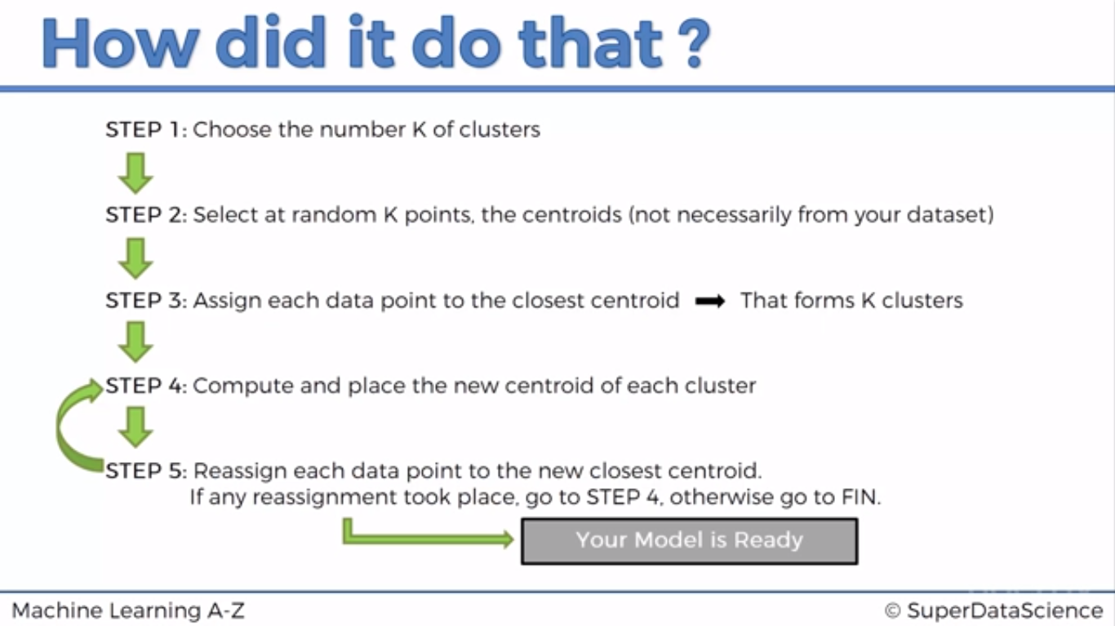
K-Means Clustering

Slide 33
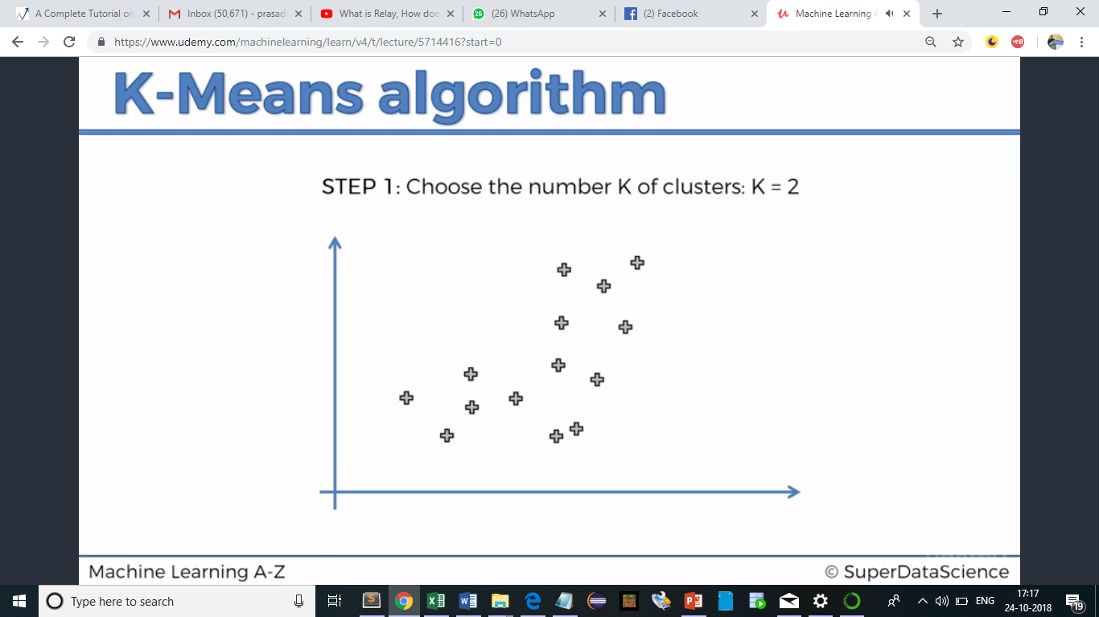
K-Means Clustering

Slide 34
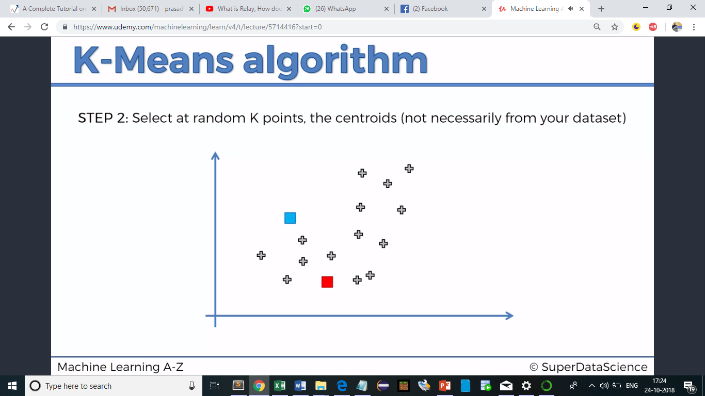
K-Means Clustering

Slide 35
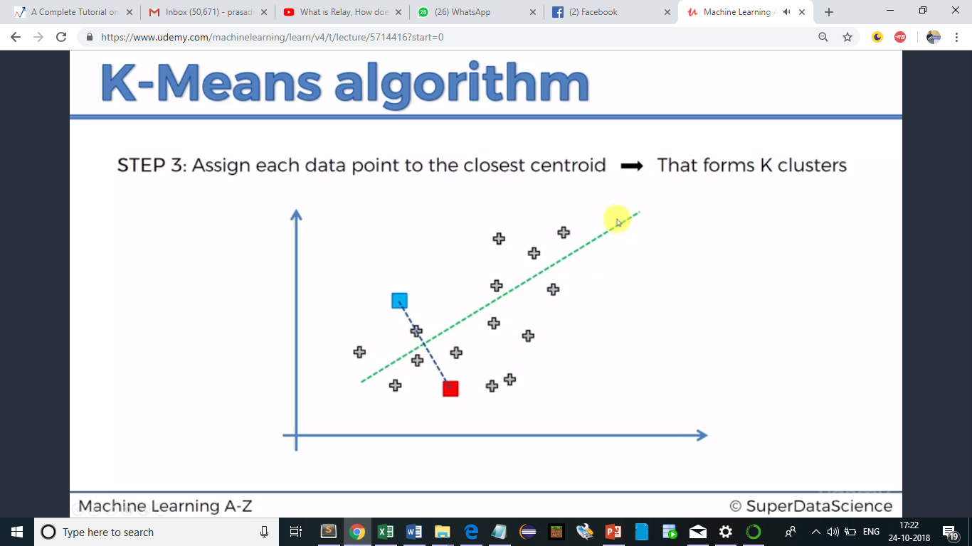
K-Means Clustering

Slide 36
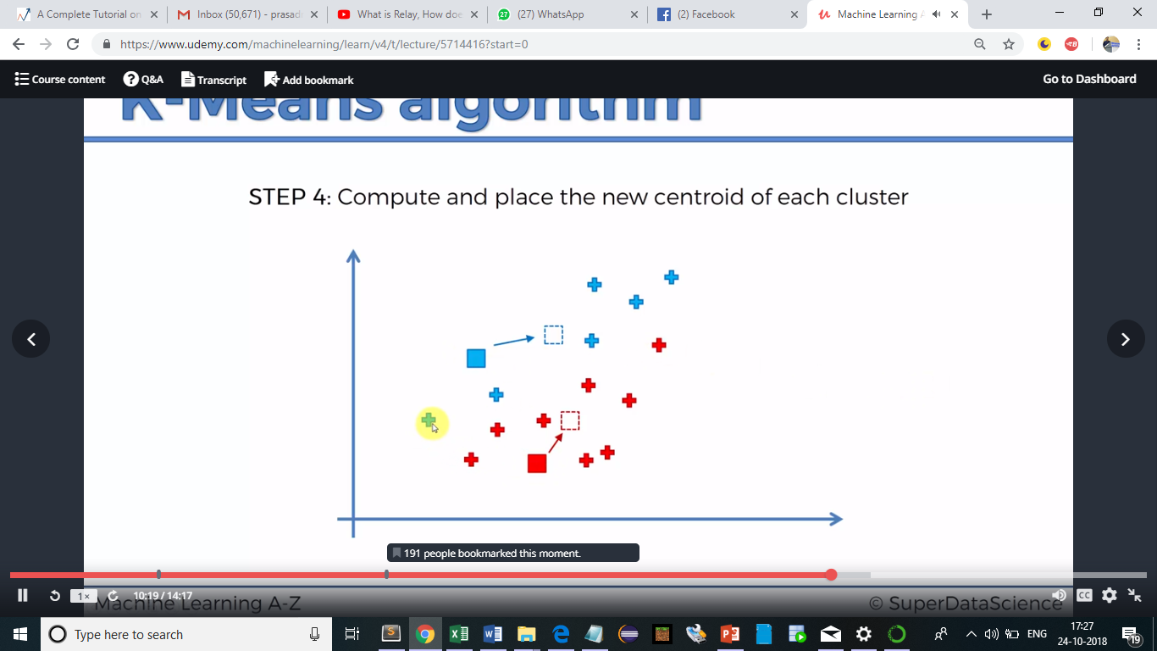
K-Means Clustering

Slide 37
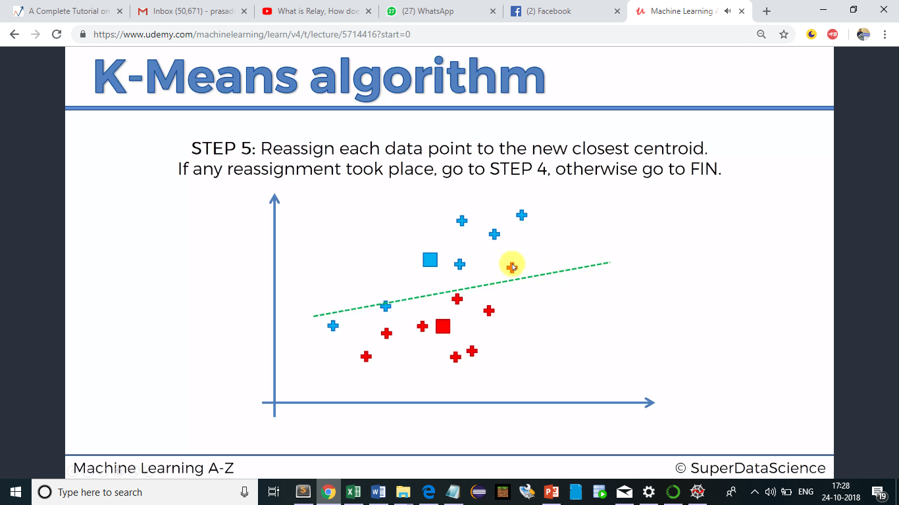
K-Means Clustering

Slide 38
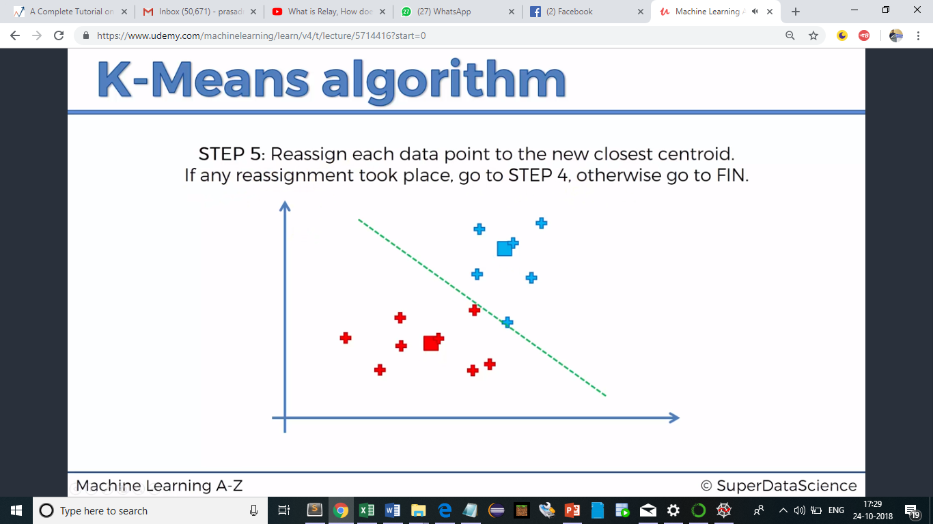
K-Means Clustering

Slide 39

K-Means Clustering

Slide 40
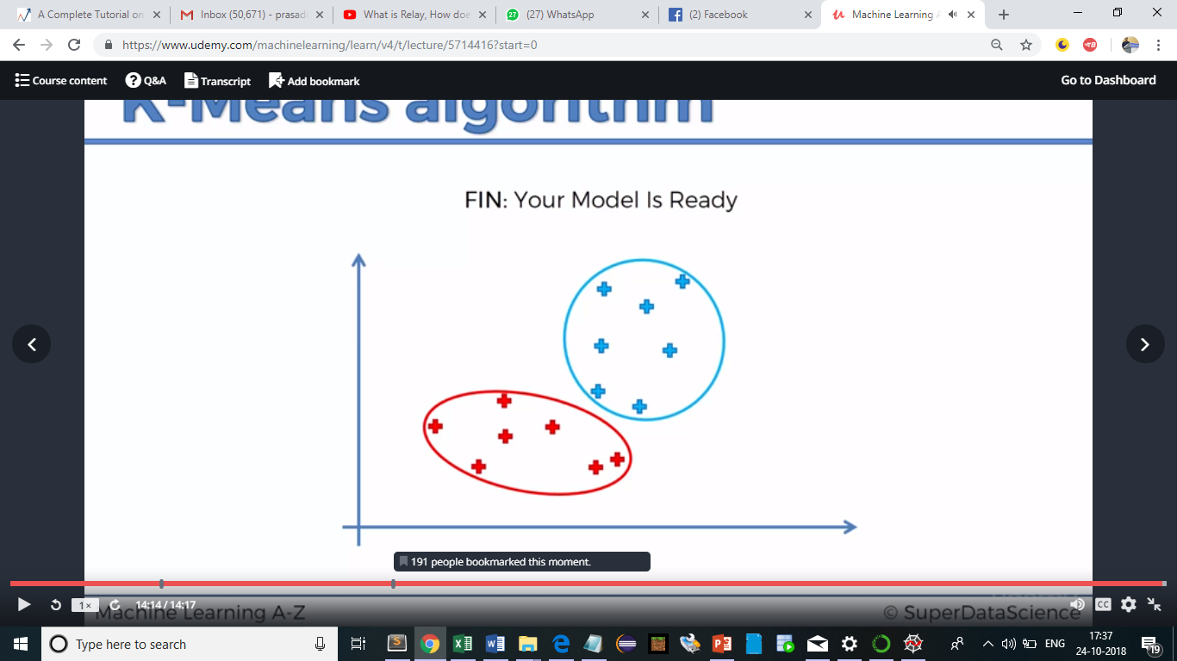
K-Means Clustering

Slide 41
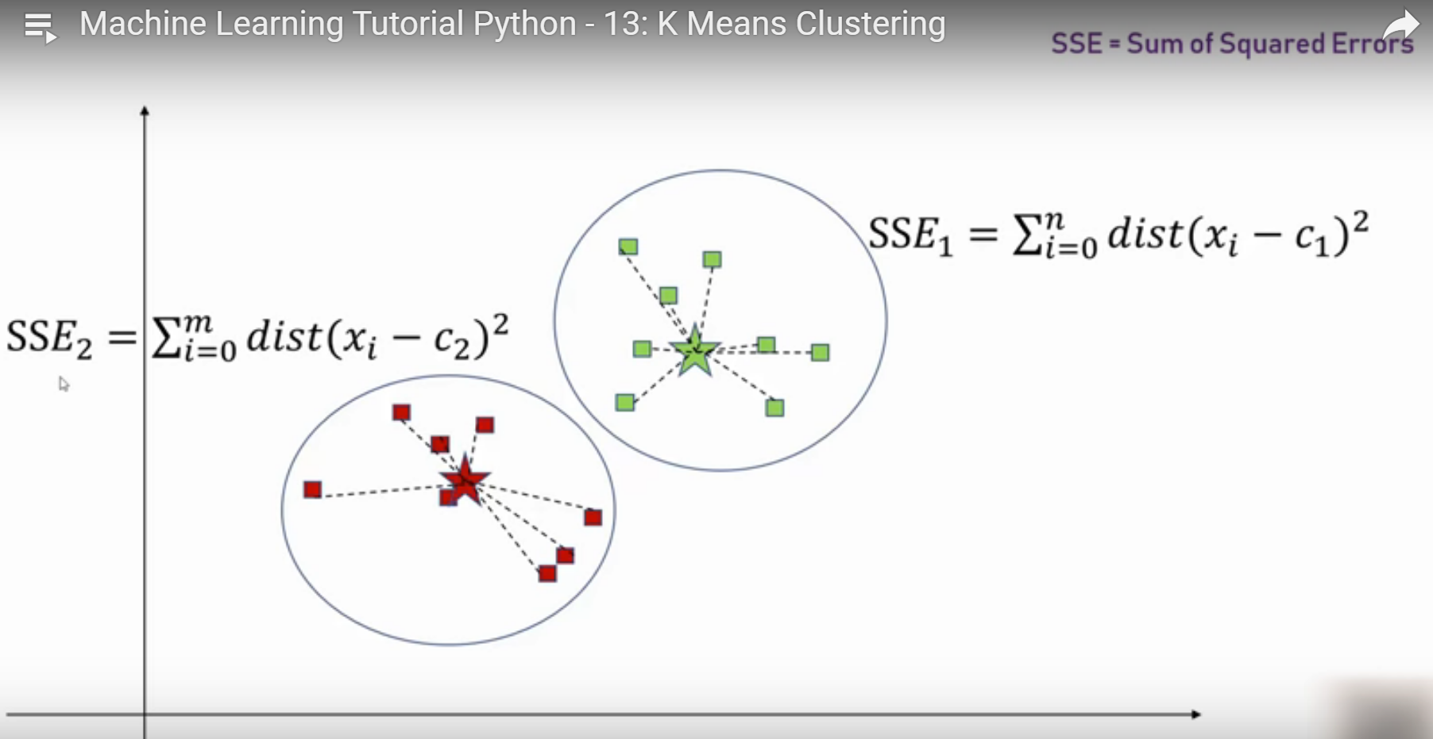
K-Means Clustering – Finding K

Slide 42
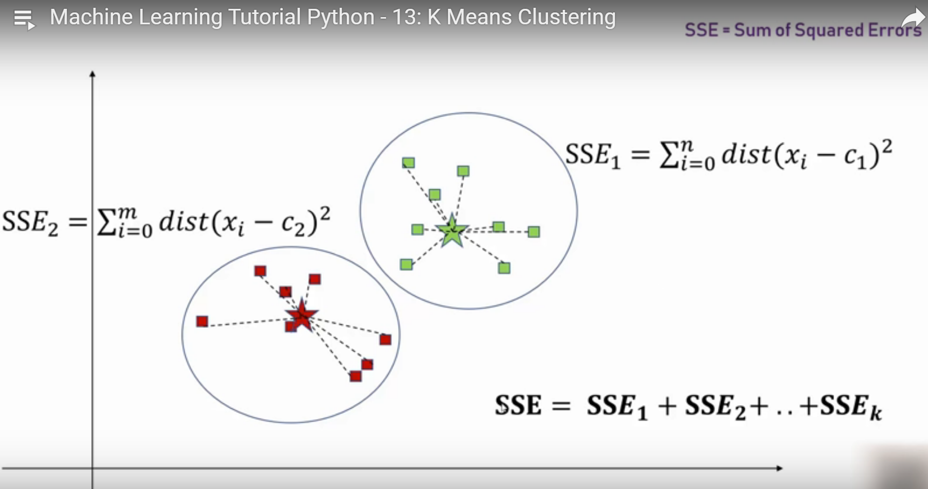
K-Means Clustering – Finding K

Slide 43
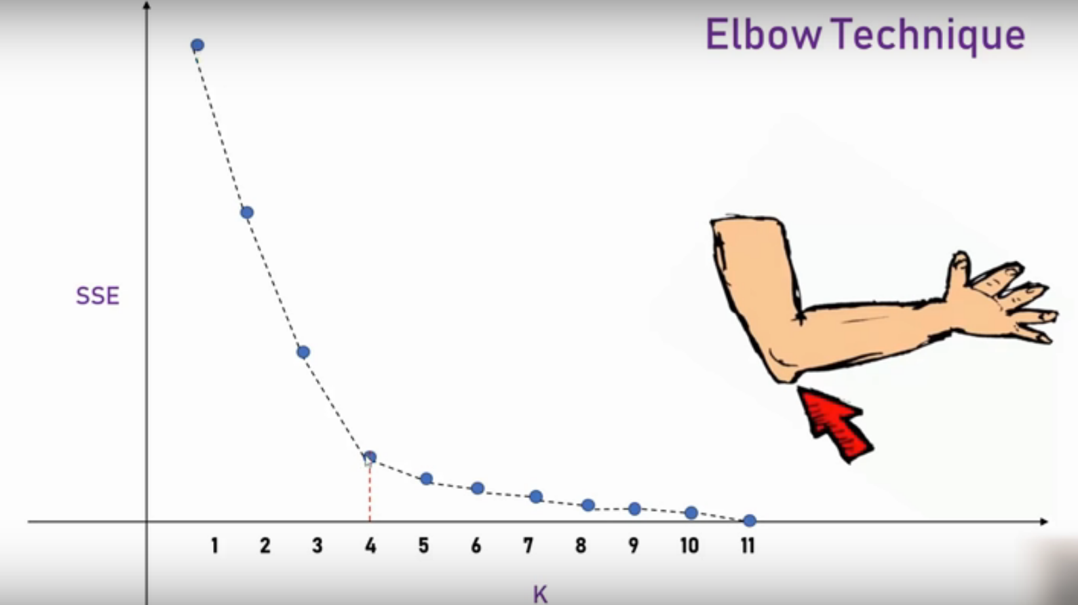
K-Means Clustering – Elbow method

Slide 44

Selection of algorithm

